Slide 1

Car Image Recognition for the Finance Industry
Nick Montana
4/26/2018

Slide 2
Problem
Developing an app that can label the specification of a car to use for giving insurance rates or financing options
Finance industry
Convenience
Goal:
Image → Classification → Insurance/Finance

Slide 3
Method
Data Set:
Fatkun Image Downloader – Google Chrome Extension
Google Images
Each category has 200 images (extremely small for CNN)
Image Classification:
Retraining via Transfer Learning by adding new layers to a CNN
Tensor Flow

Slide 4

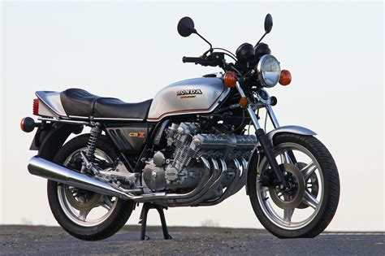
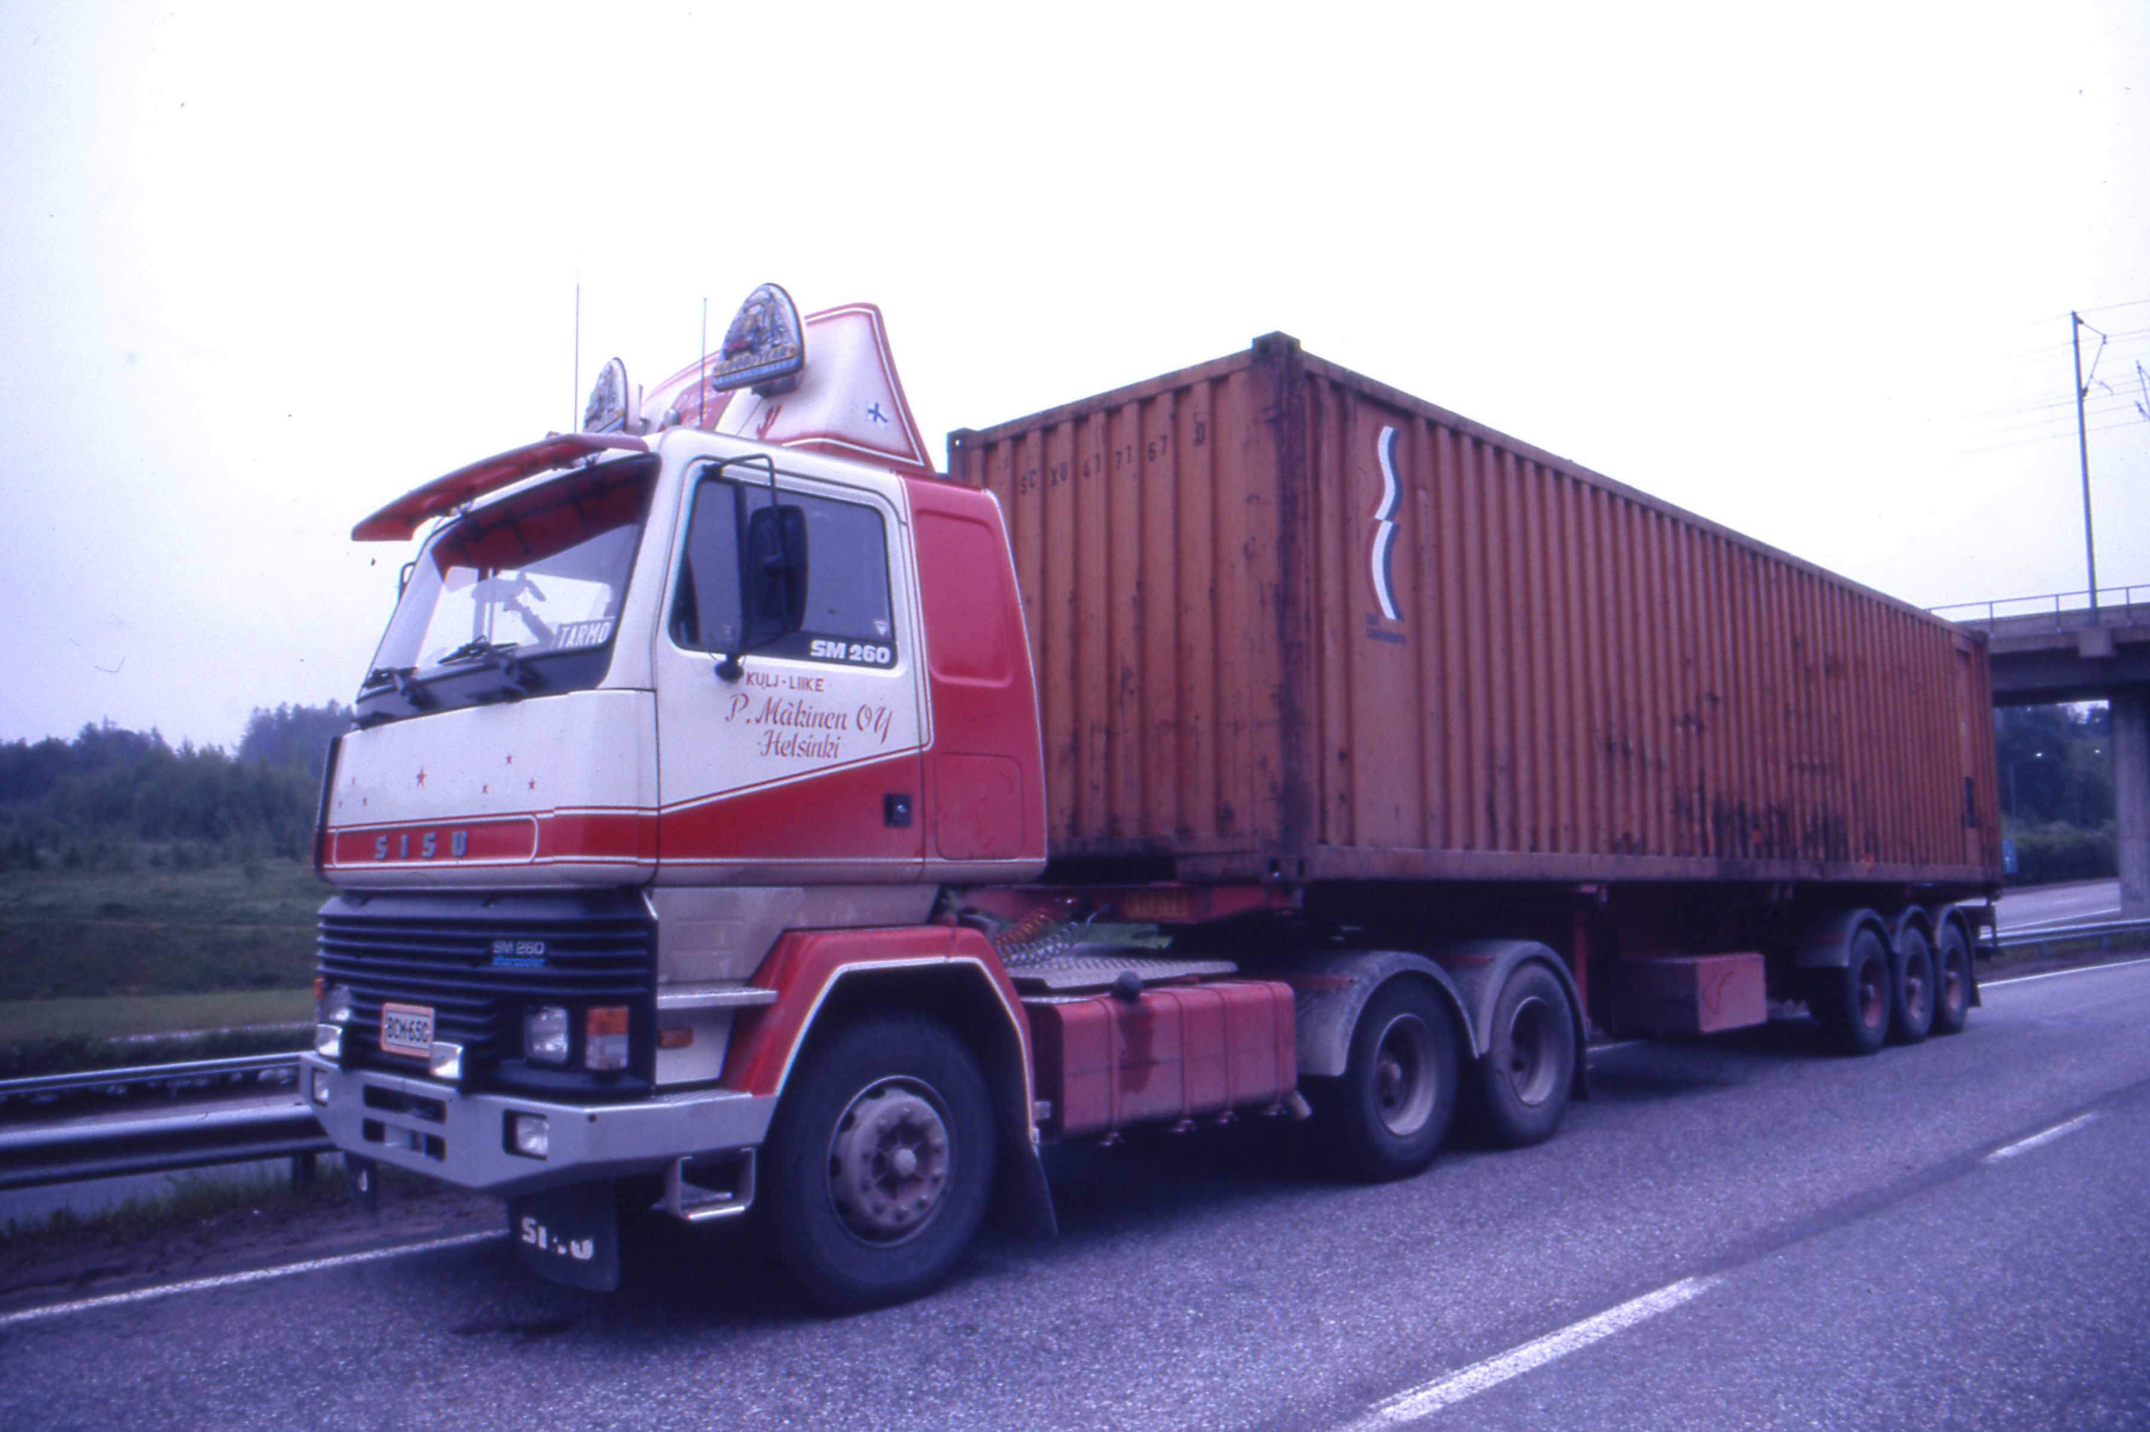
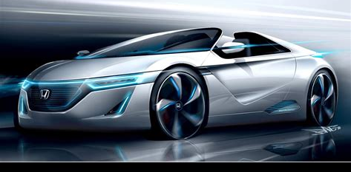
Optimizing the Dataset: Removing inconsistencies
Truck:
Honda:

Slide 5
Results and Problems
First Attempt: Distinguish between car brands: Honda, Benz, Nissan, etc.
Second Attempt: Distinguish between car types: sedan, truck, suv, and minivan

Slide 6
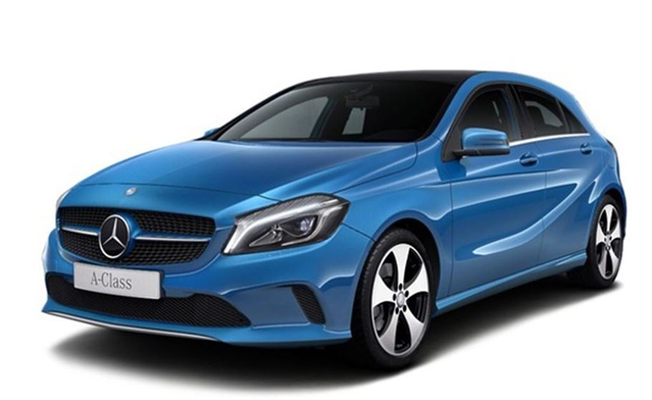
Is it a Honda or a Benz?
Evaluation time (1-image): 0.306s
honda 0.9936724
benz 0.0063276207

Slide 7
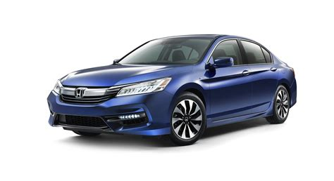
Why Can’t it distinguish between a Honda a Benz? Features…

Slide 8
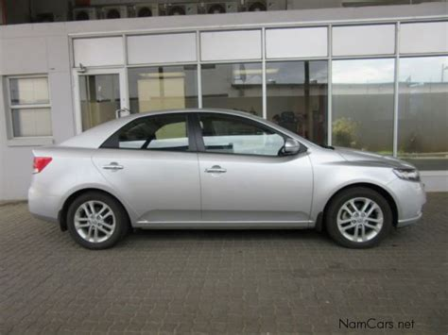
Better Results: Distinguish between sedan, truck, suv, minivan
Evaluation time (1-image): 0.243s
sedan 0.9746996
truck 0.014940049
minivan 0.008166661
suv 0.0021936775

Slide 9
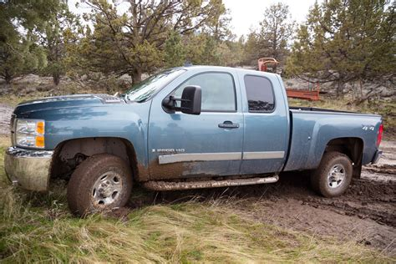
Better Results: Distinguish between sedan, truck, suv, minivan
Evaluation time (1-image): 0.255s
truck 0.99960965
suv 0.0003345982
minivan 5.460718e-05
sedan 1.2225661e-06

Slide 10
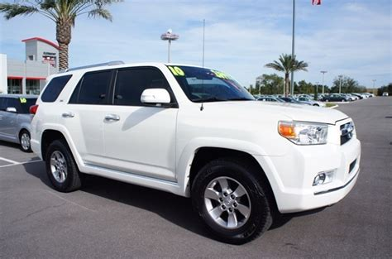
BUT Struggles with distinguishing b/t minivan and suv
Evaluation time (1-image): 0.242s
minivan 0.4301378
suv 0.40078053
truck 0.1587362
sedan 0.010345485

Slide 11
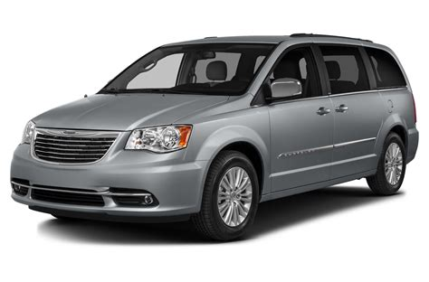
(Sometimes)
Evaluation time (1-image): 0.278s
minivan 0.9998815
sedan 0.00011783842
suv 6.2436555e-07
truck 5.9809525e-11

Slide 12
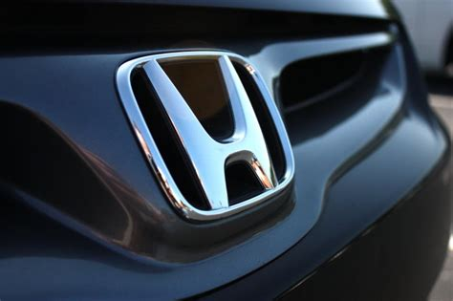
Conclusion and Future Work
Most problems occurred due to dataset
Try a similar method using a shallow Support Vector Machine
Identify car brand logo in an image and classify it
Work with a finace Company to get a data set for insurance rates/financing options. Use Linear Regression with Multiple variables (see hw1)

Slide 13
Literature Survey and Questions?
Han, Dongmei, Liu, Qigang, Fan, Weguo. “A new image classification method using CNN transfer learning and web data augmentation.” Expert Systems With Applications, vol. 95, 2018, http://www.elsevier.com/locate/eswa. Accessed 6 March 2018.
Shi, Kaijing, Bao, Hong, Ma, Nan. “Forward Vehicle Detection Based on Incremental Learning and Fast R-CNN.” IEEE: International Conference on Computational Intelligence and Security, 2017.
Background Info: Professor Yan Yan’s Lecture Slides
TensorFlow: www.tensorflow.org.

